Slide 1
Angular 2 observables in angular 2: introduction

Slide 2
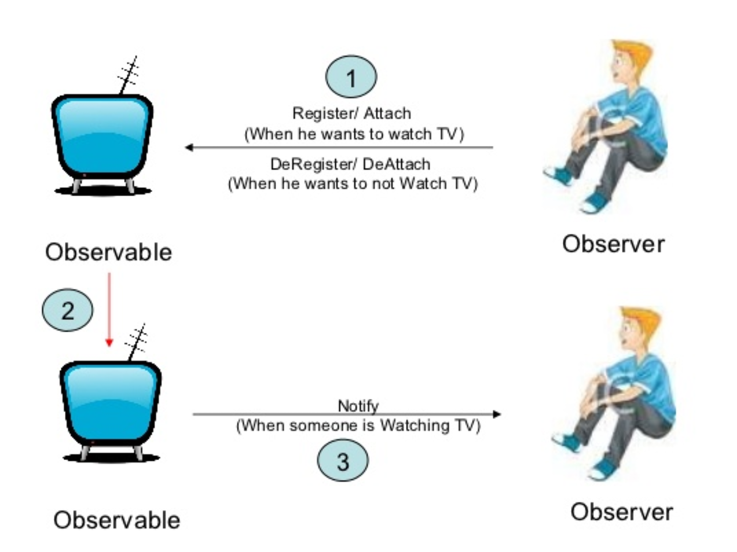
Observable pattern

Slide 3
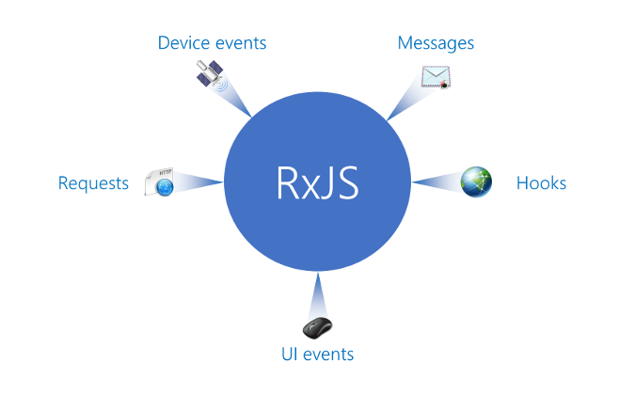
rxjs

Slide 4
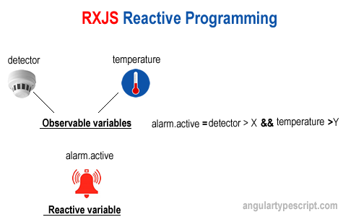

Slide 5
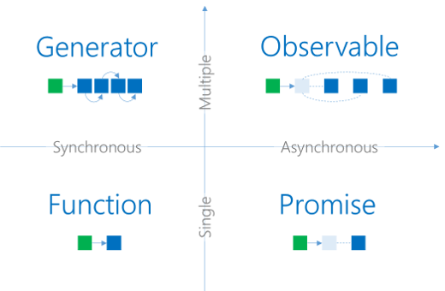
Data producers

Slide 6
Create and subscribe observable
var observable = Observable.create(function (observer) { observer.next(42); observer.next(42); observer.complete(); });
var subscription = observable.subscribe( function (value) { console.log('Next: %s.', value); }, function (ev) { console.log('Error: %s!', ev); }, function () { console.log('Completed!'); } ); subscription.dispose();
Notes:
As a best practice we should terminate the subscription by using the dispose method. This will perform any required cleanup steps. Otherwise, it might be possible to prevent garbage collection from cleaning up unused resources.
Without subscribe the observable contained in the variable observable is just a cold observable. Nevertheless, it is also possible to convert it to a hot sequence (i.e., we perform a pseudo subscription) using the publish method.

Slide 7
How to get observable?
Observable creation helpers in RxJS
• Observable.of(value, value2, value3, …)
• Observable.from(promise/iterable/observable)
• Observable.fromEvent(item, eventName)
• Angular’s HTTP and Realtime Data services
• Many community-driven RxJS modules and libraries

Slide 8
Observable error handling
myObservable.catch(error => { if (error instanceof OkayError) { return Observable.of("okay"); } else { throw error; } });

Slide 9
Component with promises
@Component({ templateUrl: '../html/films.html' }) export class FilmsComponent { title: string = 'Films'; filmsPromiseArray: FilmModel[] = new Array(); errorMessage: string; constructor( private _http: Http) { } ngOnInit() { this.getFilmsPromise().then(items => this.filmsPromiseArray = items); } getFilmsPromise(): Promise<FilmModel[]> { return this._http.get('http://swapi.co/api/films') .toPromise() .then((response) => response.json().results); } }

Slide 10
Component with observable
export class FilmsComponent { title: string = 'Films'; films: FilmModel[]; constructor(private _http: Http) { } ngOnInit() { this.getFilmsObservable() .subscribe(data => this.films = data); } getFilmsObservable(): Observable<FilmModel[]> { return this._http.get('http://swapi.co/api/films') .map((response: Response) => response.json() as FilmModel[]) .do(data => console.log(JSON.stringify(data))) .catch(this.handleError); } private handleError(error: Response) { console.error(error); return Observable.throw(error.json().error || 'Server error'); } }

Slide 11
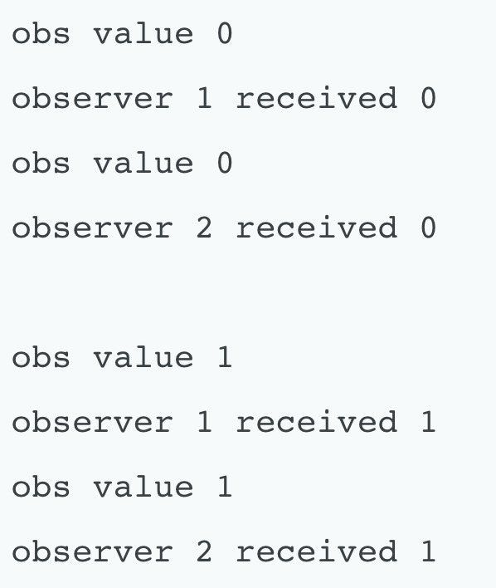
Hot and cold observables
Hot observables are pushing even when we are not subscribed to them (e.g., UI events).
Cold observables start pushing only when we subscribe. They start over if we subscribe again.
var obs = Observable.interval(500).take(5) .do(i => console.log("obs value "+ i) ); obs.subscribe(value => console.log(
"observer 1 received " + value)); obs.subscribe(value => console.log(
"observer 2 received " + value));
When we create a subscriber, we are setting up a whole new separate processing chain.
Observable is not shared: each subscriber get its own copy.

Slide 12
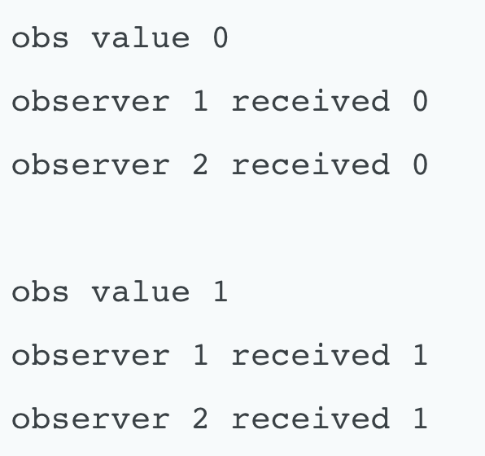
Share operator
The share operator allows to share a single subscription of a processing chain with other subscribers.
var obs = Observable.interval(500).take(5) .do(i => console.log("obs value "+ i) ) .share(); obs.subscribe(value => console.log(
"observer 1 received " + value)); obs.subscribe(value => console.log(
"observer 2 received " + value));

Slide 13
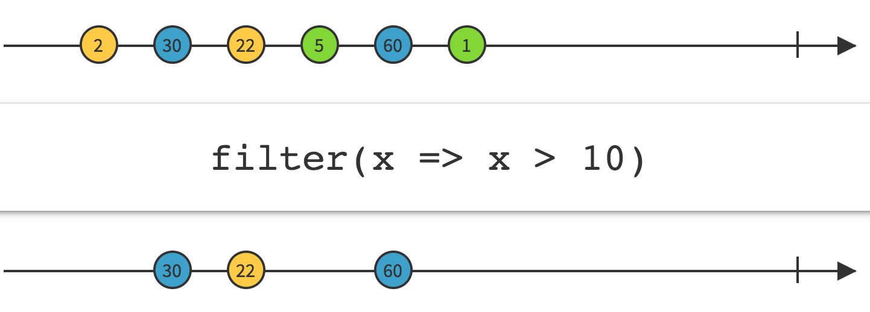
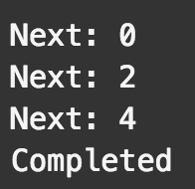
Filter operator
var source = Observable.range(0, 5) .filter(function (x, idx, obs) { return x % 2 === 0; }); var subscription = source.subscribe( function (x) { console.log('Next: %s', x); }, function (err) { console.log('Error: %s', err); }, function () { console.log('Completed'); });

Slide 14
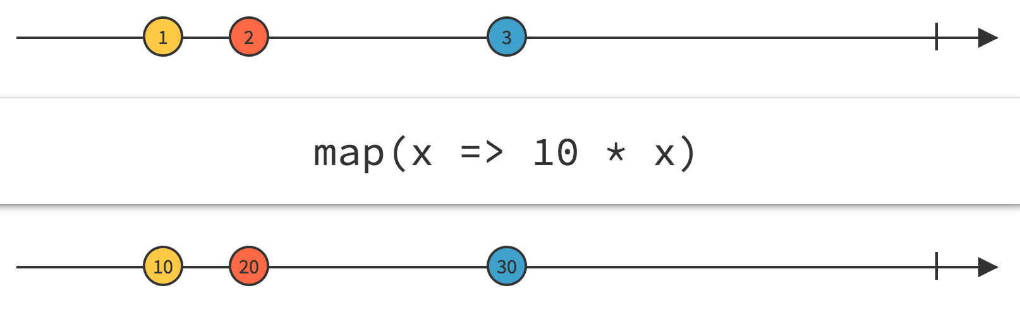
Map operator
// Using a value var md = Observable.fromEvent(document, 'mousedown')
.map(e=>{ return { x:e.x, y: e.y} });
var subscription = source.subscribe( function (a) { console.log(’Mouseclick at (${a.x},${a,y}) ‘); }, function (err) { console.log('Error: ' + err); }, function () { console.log('Completed'); });

Slide 15
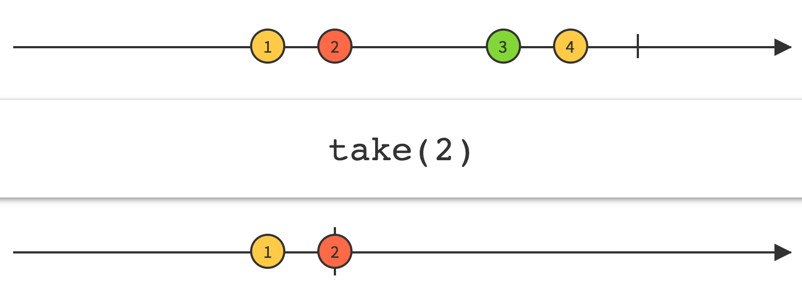
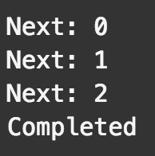
Take operator
var source = Observable.range(0, 5).take(3); var subscription = source.subscribe( function (x) { console.log('Next: ' + x); }, function (err) { console.log('Error: ' + err); }, function () { console.log('Completed'); });

Slide 16
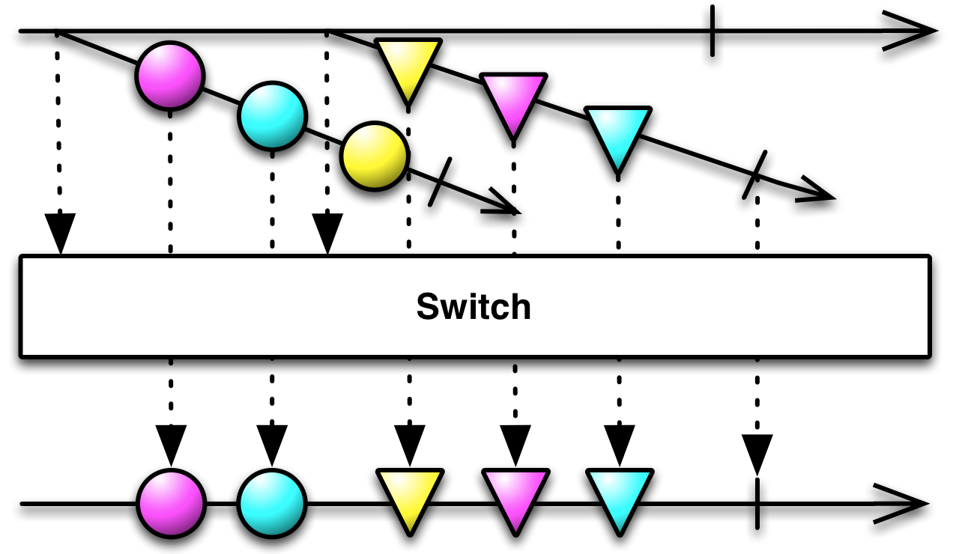
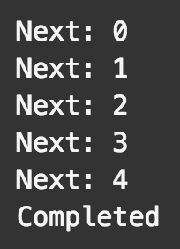
Switch operator
var source = Observable.range(0, 3) .map(function (x) { return Observable.range(x, 3); }) .switch(); var subscription = source.subscribe( function (x) { console.log('Next: ' + x); }, function (err) { console.log('Error: ' + err); }, function () { console.log('Completed'); });
0 1 2
0 1 2
1 2 3
2 3 4
switch
switch
0
1
2 3 4
timeline

Slide 17
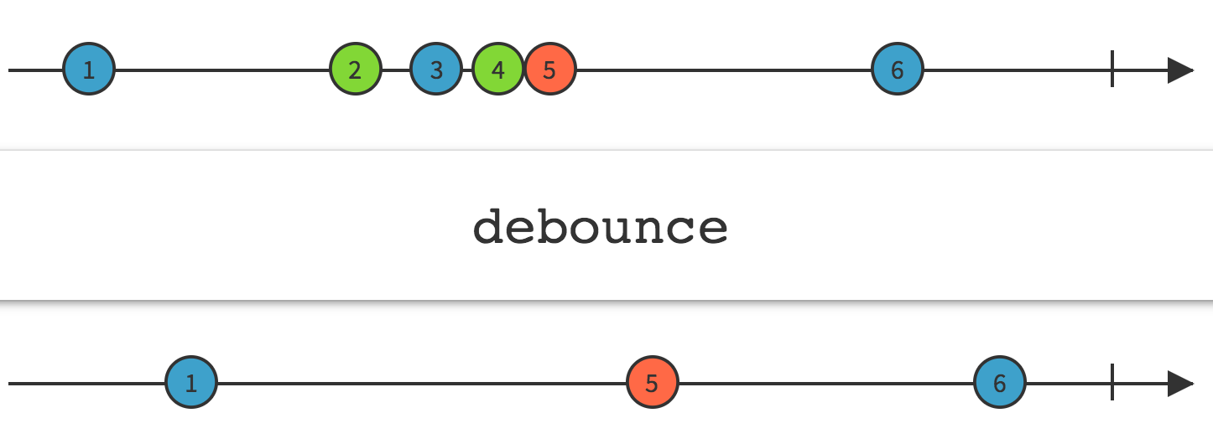
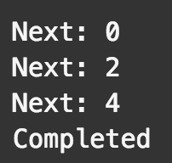
Debounce operator
The Debounce technique allow us to "group" multiple sequential calls in a single one.
Debouncing enforces that a function not be called again until a certain amount of time has passed without it being called. As in "execute this function only if 100 milliseconds have passed without it being called."
0
100 0
200
300
400
500
600 debounce
700 1
800
900
1000
1100 2
1200
1300
1400
1500
1600 debounce
…
// Delay each item by time and project value; var source = Observable.from(times) .flatMap(function (item) { return Rx.Observable .of(item.value) .delay(item.time); }) .debounce(500 /* ms */); var subscription = source.subscribe( (x)=>console.log('Next: %s', x));
var times = [ { value: 0, time: 100 }, { value: 1, time: 600 }, { value: 2, time: 400 }, { value: 3, time: 700 }, { value: 4, time: 200 } ];
500ms
500ms

Slide 18
Processing input box changes with rxjs
@Component({ selector: 'my-app', template: `<input [formControl]="searchBox" /> {{searchResults}} ` }) export class App { searchBox: FormControl = new FormControl(); searchResults: string; constructor(httpService: HttpService) { this.searchBox.valueChanges .debounceTime(500) .distinctUntilChanged() .switchMap(data => this.httpService.getListValues(data)) .subscribe(res=>this.searchResults=res, (err: Error) => console.log(err)); } }

Slide 19
How angular 2 use observables?
Angular 2 currently uses RxJs Observables in two different ways:
as an internal implementation mechanism, to implement some of its core logic like EventEmitter
as part of its public API, namely in Forms and the HTTP module

Slide 20
